Slide 1
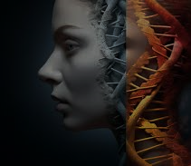
Detection of Schizophrenia From Social Media
By Team 14:
21071A6614 – Kalyan Ram Challa
21071A6634 – M. Vijaya Sai
21071A6651 – Prachet Yerramalla
22075A6601 – Kolloju Chandan
Guide:
Mr. K. Sreenivasa Rao
Asst. Professor, Dept. of CSE(AIML & IoT)

Slide 2
Abstract
Schizophrenia is a mental disorder that affects a person's ability to think, feel and behave clearly.
Early detection and intervention are crucial for preventing the disorder to grow in to dangerous level.
However, many cases of schizophrenia remain untreated due to failure to diagnose and self-denial.
With the advent of social media, individuals suffering from schizophrenia share their mental health problems.
Machine learning approaches are increasingly used for detecting schizophrenia from social media posts.
This project aims to determine whether machine learning could be effectively used to detect signs of schizophrenia in social media users by analyzing their social media texts.

Slide 3
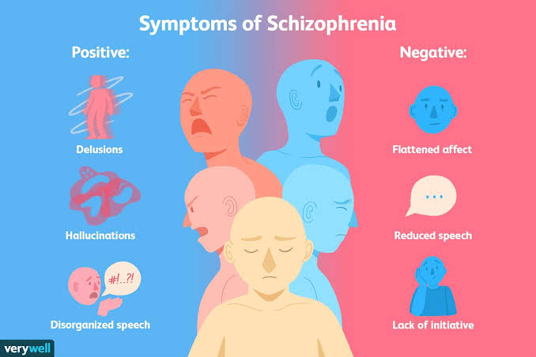
Introduction
Schizophrenia presents both positive, negative and cognitive symptoms.
Individuals with schizophrenia are at an elevated suicide risk, a lifetime rate of suicide in individuals is approximately 10%.
Social media is increasingly used by those with schizophrenia for sharing mental health concerns, connecting with others who have similar mental health experiences.
Reference: https://www.verywellmind.com/what-are-the-symptoms-of-schizophrenia-2953120

Slide 4
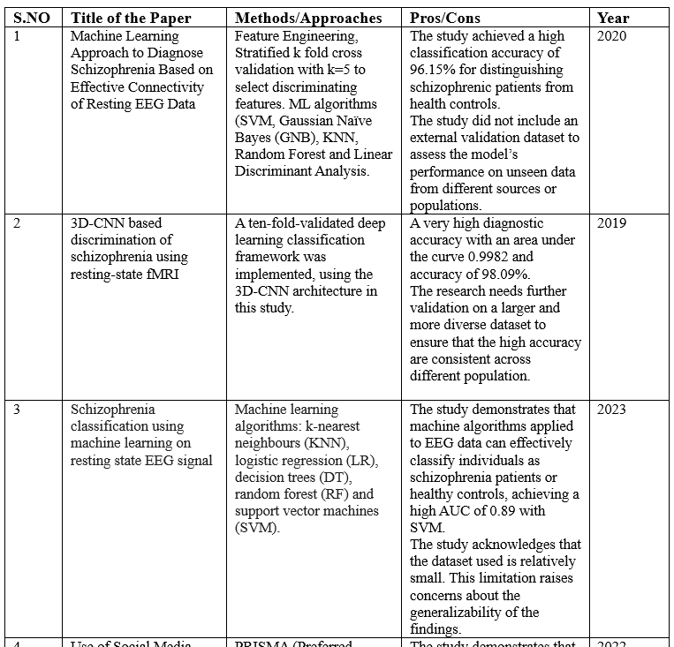
Literature Survey

Slide 5
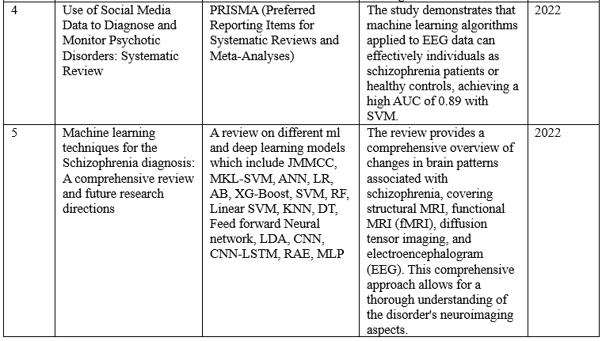

Slide 6
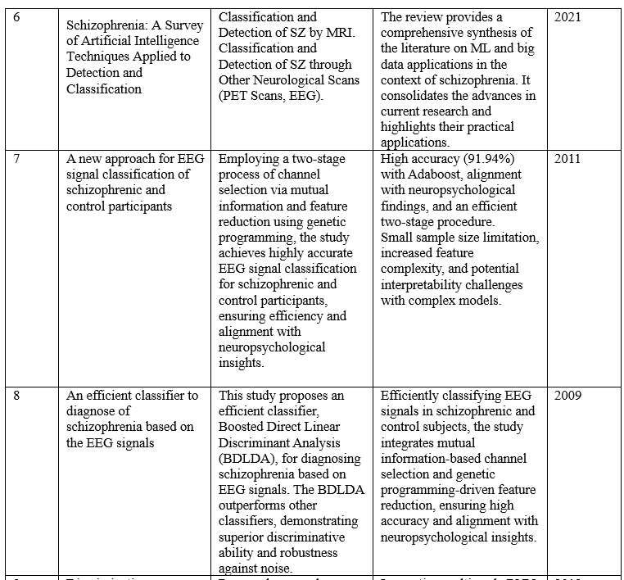

Slide 7
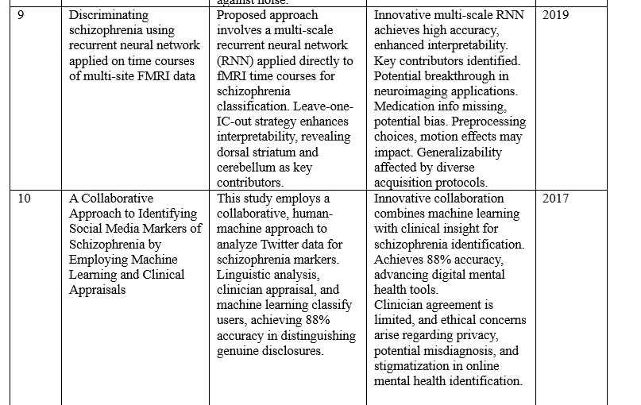

Slide 8
Existing System
In the existing system, schizophrenia is detected by using the machine Learning algorithm with Magnetic Resonance Images (MRI) datasets that contains MR images of human brains.
Previously, SVMs (support vector machines) were used for classifying the schizophrenic posts.
Disadvantages:
The quality of MRI scans can vary with costs and depends on various other factors so we cannot use it as a standard dataset.
It also needs the user to know that he might have schizophrenia beforehand and only then it can be predicted.
It needs MRI scans of the patients for predicting schizophrenia.

Slide 9
Proposed System
The main objective is to detect Schizophrenia using social media posts.
It aims to identify schizophrenia in the early stages itself so that it can be easily diagnosed preventing the disorder to grow into dangerous levels.
We collected posts from the social media platform Reddit focusing on schizophrenia, along with non-mental health related posts for the control group.
Using supervised machine learning, we classified posts belonging to schizophrenia and interpreted important features to identify linguistic markers of schizophrenia.
We identified significant differences in linguistic features and topics including increased use of third person plural pronouns and negative emotion words and symptom-related topics.

Slide 10
Advantages:
This system can employ advanced algorithms and machine learning techniques to analyze and provide early detection for schizophrenia.
Social media platforms generate vast amounts of user-generated content. By leveraging all the data, this proposed system can analyze a large number of posts, comments, and interaction that allows for a broader scope of analysis compared to traditional diagnostic methods.
Implementing this system that analyzes social media data can be cost-effective than traditional diagnostic procedures that often involve multiple appointments and clinical evaluations, which can be time-consuming.
Social media data can provide a continuous stream of information about an individual's thoughts and emotions, unlike traditional clinical assessments that rely on self-reporting or periodic evaluations.

Slide 11
Functional Requirements :
Data Collection and Integration
Sentiment Analysis:
Anomaly Detection
Temporal Analysis
Semantic Content Analysis
User Interaction Patterns
Multimodal Data Analysis

Slide 12
Non Functional Requirements:
Accuracy and Reliability
Privacy and Data Security
Ethical Considerations
Scalability
Response Time
Interoperability
Algorithm Transparency
Bias Mitigation

Slide 13
Scope
Early Detection and Awareness
Support and Resources
Risk Assessment
Privacy and Consent
False Positives and Ethical Concerns
Collaboration with Healthcare Professionals
Continuous Improvement and Validation

Slide 14
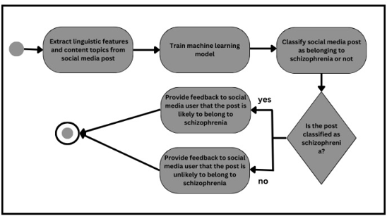
UML Diagrams

Slide 15
Plan Of Action
Social media posts from individuals with schizophrenia and a control group
Data Collection
Data Processing
Selecting Appropriate models
Model training
Model evaluation
Gathering feedback and interaction
Deployment
From users and mental health professionals, also helps to improve the model
Text cleaning, tokenization, and irrelevant info removal
Multinomial NB (Naïve Bayes)
for text classification
Secure and scalable system with user-friendly interface containing the trained model.
(synonym gathering)
Accuracy, F1-score (crucial factor)
SGD (Stochastic Gradient Descent) for model optimization

Slide 16
Implementation
http://localhost:8888/notebooks/Notebook.ipynb
https://verbose-disco-w6xj7xrqgvr3g5jp.github.dev/?autoStart=false
https://github.com/prachetyerr/schizophrenia-detector-sip

Slide 17
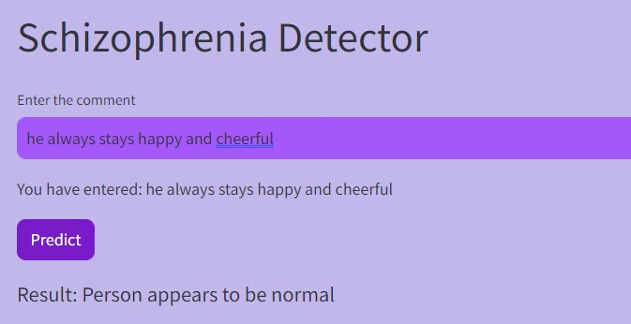
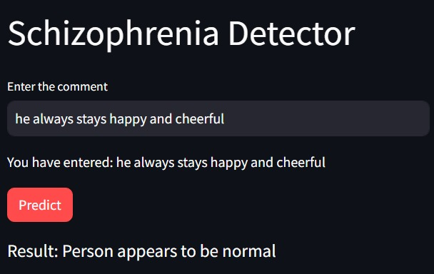
UI Screens
Light Theme
Dark Theme

Slide 18
Conclusion
The project successfully demonstrated the application of natural language processing and machine learning for the purpose of identifying possible signs of schizophrenia based on textual content.
The SGD model, with its 93% accuracy, emerged as the preferred choice for predicting suicidal tendencies.
It is essential to approach the model's predictions with caution and consider ethical implications, emphasizing that the tool is intended to be a supportive aid rather than a definitive diagnosis.
Future work may involve refining the model, incorporating more diverse datasets, and collaborating with mental health professionals to ensure responsible and ethical use of the tool in real-world scenarios.

Slide 19
Reference Links
https://ieeexplore.ieee.org/document/9353622
https://doi.org/10.1016/j.artmed.2019.06.003
https://doi.org/10.1016/j.bspc.2022.104233
https://www.ncbi.nlm.nih.gov/pmc/articles/PMC9490531/#:~:text=Conclusions,about%20accuracy%20in%20clinical%20situations.
https://link.springer.com/article/10.1007/s12652-023-04536-6
https://www.researchgate.net/publication/352191343_Schizophrenia_A_Survey_of_Artificial_Intelligence_Techniques_Applied_to_Detection_and_Classification
https://doi.org/10.1016/j.eswa.2010.07.145
https://doi.org/10.1016/j.eswa.2008.07.037
https://doi.org/10.1016/j.ebiom.2019.08.023
https://www.jmir.org/2017/8/e289/

Slide 20
THANK YOU

